Slide 1
Module 2
symmetric and asymmetric key Cryptography and key management

Slide 2
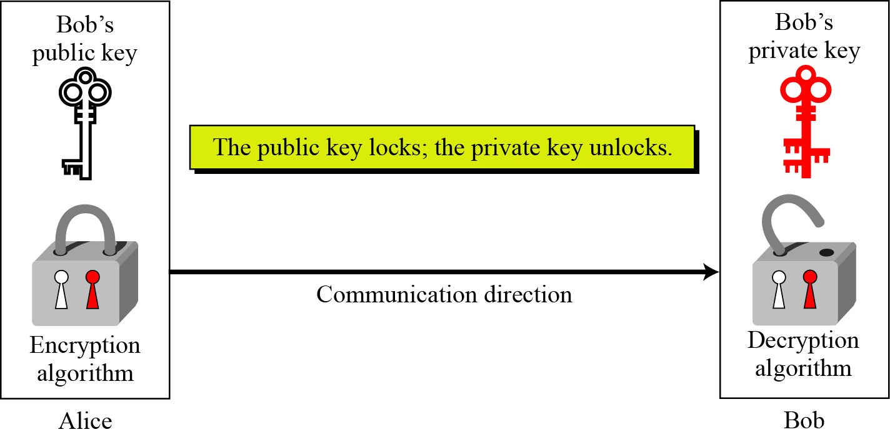
Public key cryptography
Public key cryptography (also known as public-key encryption and asymmetric encryption). Asymmetric key cryptography uses two separate keys: one private and one public.
Fig. Locking and unlocking in asymmetric-key cryptosystem

Slide 3
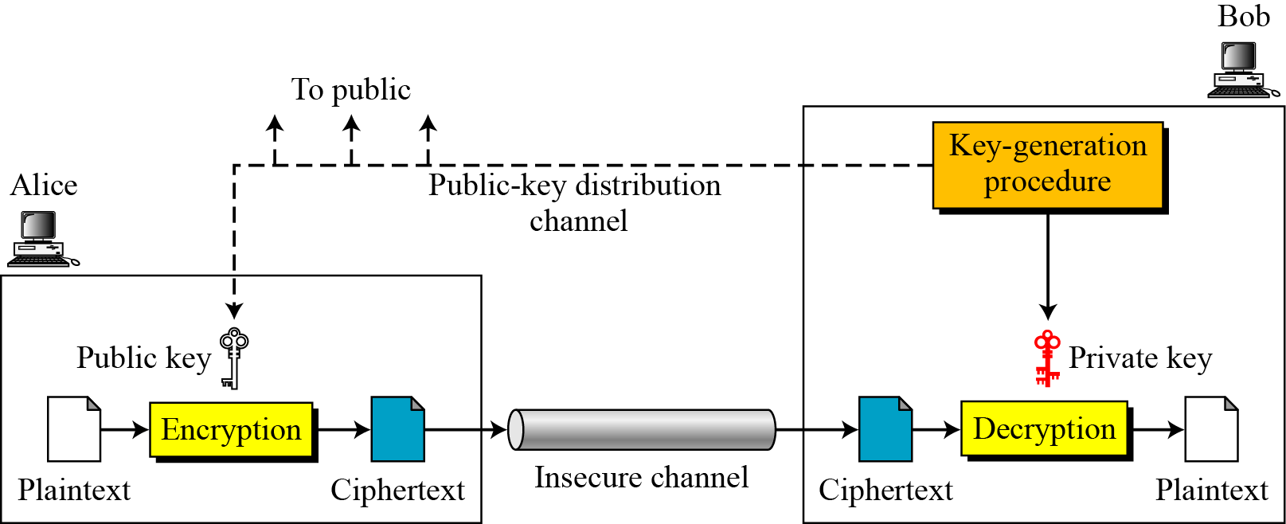
Public key cryptography
Fig. General idea of asymmetric-key cryptosystem

Slide 4
Public key cryptography
Plaintext/Ciphertext
Unlike in symmetric-key cryptography, plaintext and ciphertext are treated as integers in asymmetric-key cryptography.
Encryption/Decryption
C = e(K_{public} , P) P = d(K_{private} , C)

Slide 5
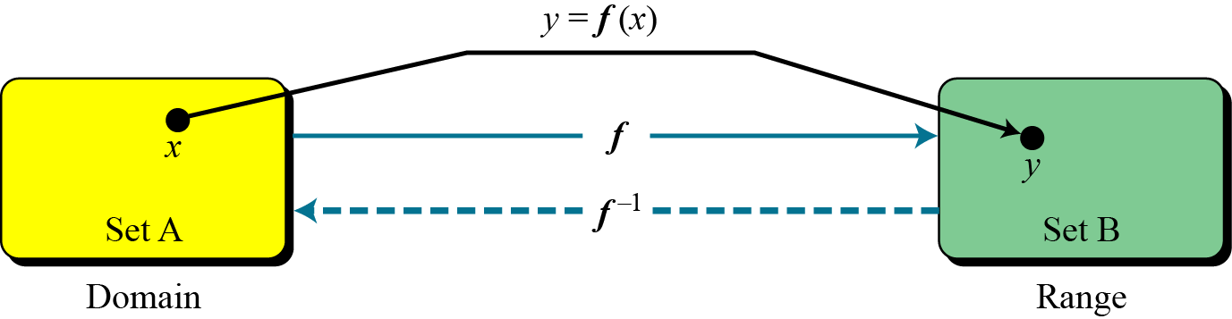
Trapdoor one-way function
The main idea behind asymmetric-key cryptography is the concept of the trapdoor one-way function.
Fig. A function as rule mapping a domain to a range

Slide 6
Trapdoor one-way function
One-Way Function (OWF)
1. f is easy to compute.
2. f ⁻¹ is difficult to compute.
Trapdoor One-Way Function (TOWF)
3. Given y and a trapdoor, x can be
computed easily.

Slide 7
Principles of Public key cryptosystem
Public-Key Cryptosystems
Asymmetric algorithms rely on one key for encryption and a different but related key for decryption. These algorithms have the following important characteristic.
It is computationally infeasible to determine the decryption key given only knowledge of the cryptographic algorithm and the encryption key.
In addition, some algorithms, such as RSA, also exhibit the following characteristic.
Either of the two related keys can be used for encryption, with the other used for decryption.

Slide 8
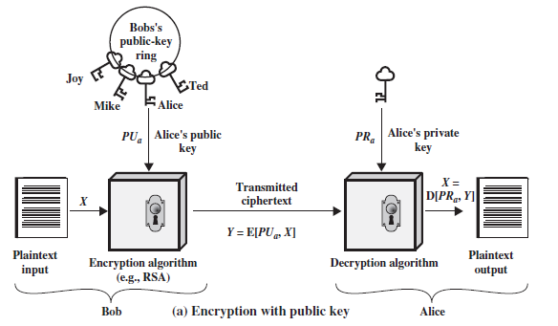
Principles of Public key cryptosystem
Public-Key Cryptosystems
A public-key encryption scheme has six ingredients
Fig.1.a Public-Key Cryptography
Plaintext: This is the readable message or data that is fed into the algorithm as input.

Slide 9
Principles of Public key cryptosystem
Encryption algorithm: The encryption algorithm performs various transformations on the plaintext.
Public and private keys: This is a pair of keys that have been selected so that if one is used for encryption, the other is used for decryption. The exact transformations performed by the algorithm depend on the public or private key that is provided as input.
Ciphertext: This is the scrambled message produced as output. It depends on the plaintext and the key. For a given message, two different keys will produce two different ciphertexts.
Decryption algorithm: This algorithm accepts the ciphertext and the matching key and produces the original plaintext.

Slide 10
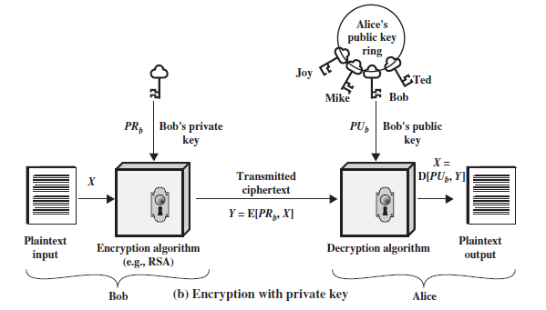
Principles of Public key cryptosystem
Public-Key Cryptosystems
Fig.1.b Public-Key Cryptography

Slide 11
Principles of Public key cryptosystem
The essential steps are the following:
1. Each user generates a pair of keys to be used for the encryption and decryption of messages.
2. Each user places one of the two keys in a public register or other accessible file. This is the public key. The companion key is kept private. As Fig. 1.a suggests, each user maintains a collection of public keys obtained from others.
3. If Bob wishes to send a confidential message to Alice, Bob encrypts the message using Alice’s public key.
4. When Alice receives the message, she decrypts it using her private key. No other recipient can decrypt the message because only Alice knows Alice’s private key.

Slide 12
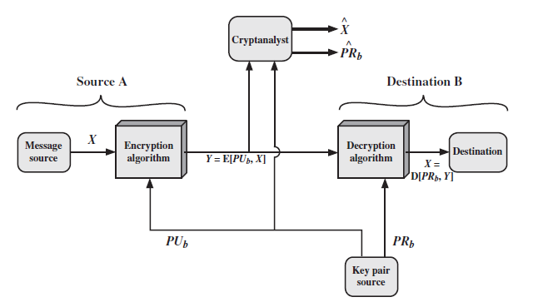
Principles of Public key cryptosystem
Fig.2 Public-Key Cryptosystem: Secrecy
There is some source A that produces a message in plaintext, X = [X₁, X₂, … , X_{M}]. The M elements of X are letters in some finite alphabet. The message is intended for destination B.

Slide 13
Principles of Public key cryptosystem
B generates a related pair of keys: a public key, PU_{b}, and a private key, PR_{b}. PR_{b} is known only to B, whereas PU_{b} is publicly available and therefore accessible by A.
With the message X and the encryption key PU_{b} as input, A forms the ciphertext Y = [Y₁, Y₂, … , Y_{N}]:
Y = E(PU_{b}, X)
The intended receiver, in possession of the matching private key, is able to invert the transformation:
X = D(PR_{b}, Y)
An adversary, observing Y and having access to PU_{b}, but not having access to PR_{b} or X, must attempt to recover X and/or PR_{b}. It is assumed that the adversary does have knowledge of the encryption (E) and decryption (D) algorithms.

Slide 14

Principles of Public key cryptosystem
If the adversary is interested only in this particular message, then the focus of effort is to recover X by generating a plaintext estimate Often, however, the adversary is interested in being able to read future messages as well, in which case an attempt is made to recover PR_{b} by generating an estimate .
We mentioned earlier that either of the two related keys can be used for encryption, with the other being used for decryption. This enables a rather different cryptographic scheme to be implemented. Whereas the scheme illustrated in Fig. 2 provides confidentiality, Fig 1.b and Fig.3 show the use of public-key encryption to provide authentication:
Y = E(PR_{a}, X)
X = D(PU_{a}, Y)

Slide 15
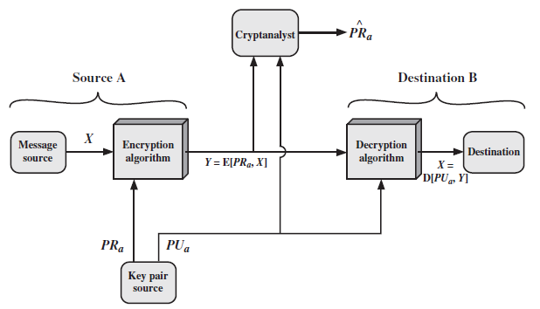
Principles of Public key cryptosystem
Fig.3 Public-Key Cryptosystem: Authentication

Slide 16
Principles of Public key cryptosystem
In this case, A prepares a message to B and encrypts it using A’s private key before transmitting it. B can decrypt the message using A’s public key. Because the message was encrypted using A’s private key, only A could have prepared the message. Therefore, the entire encrypted message serves as a digital signature.
In addition, it is impossible to alter the message without access to A’s private key, so the message is authenticated both in terms of source and in terms of data integrity.
In the preceding scheme, the entire message is encrypted, which, although validating both author and contents, requires a great deal of storage.

Slide 17
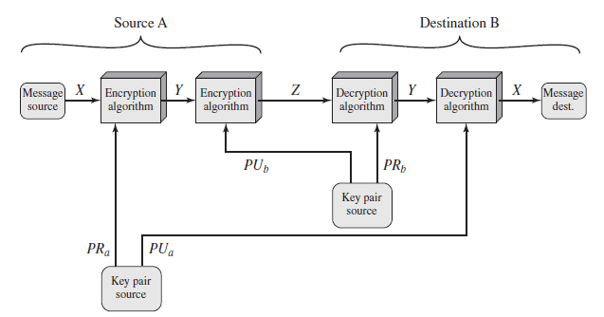
Principles of Public key cryptosystem
It is important to emphasize that the encryption process depicted in
Fig 1.b and Fig 3 does not provide confidentiality.
It is, however, possible to provide both the authentication function and confidentiality by a double use of the public-key scheme (Fig 4):
Z = E(PU_{b}, E(PR_{a}, X))
X = D(PU_{a}, D(PR_{b}, Z))
Fig.4 Public-Key Cryptosystem: Authentication and Secrecy

Slide 18
Principles of Public key cryptosystem
In this case, we begin as before by encrypting a message, using the sender’s private key. This provides the digital signature. Next, we encrypt again, using the receiver’s public key. The final ciphertext can be decrypted only by the intended receiver, who alone has the matching private key. Thus, confidentiality is provided. The disadvantage of this approach is that the public-key algorithm, which is complex, must be exercised four times rather than two in each communication.

Slide 19
Principles of Public key cryptosystem
Applications for Public-Key Cryptosystems
Public-key systems are characterized by the use of a cryptographic algorithm with two keys, one held private and one available publicly.
Depending on the application, the sender uses either the sender’s private key or the receiver’s public key, or both, to perform some type of cryptographic function. In broad terms, we can classify the use of public-key cryptosystems into three categories
Encryption/decryption: The sender encrypts a message with the recipient’s public key.
Digital signature: The sender “signs” a message with its private key. Signing is achieved by a cryptographic algorithm applied to the message or to a small block of data that is a function of the message.
Key exchange: Two sides cooperate to exchange a session key. Several different approaches are possible, involving the private key(s) of one or both parties.

Slide 20
Principles of Public key cryptosystem
Applications for Public-Key Cryptosystems
Some algorithms are suitable for all three applications, whereas others can be used only for one or two of these applications. Table 1 indicates the applications supported by the algorithms discussed in this book.
Algorithm | Encryption / Decryption | Digital Signature | Key Exchange
RSA | Yes | Yes | Yes
Elliptic Curve | Yes | Yes | Yes
Diffie-Hellman | No | No | Yes
DSS | No | Yes | No
Table 1 Applications for Public-Key Cryptosystems

Slide 21
Principles of Public key cryptosystem
Requirements for Public-Key Cryptography
1. It is computationally easy for a party B to generate a pair (public key PU_{b}, private key PR_{b}).
2. It is computationally easy for a sender A, knowing the public key and the message to be encrypted, M, to generate the corresponding ciphertext:
C = E(PU_{b}, M)
3. It is computationally easy for the receiver B to decrypt the resulting ciphertext using the private key to recover the original message:
M = D(PR_{b}, C) = D[PR_{b}, E(PU_{b}, M)]
4. It is computationally infeasible for an adversary, knowing the public key, PU_{b}, to determine the private key, PR_{b}.

Slide 22
Principles of Public key cryptosystem
Requirements for Public-Key Cryptography
5. It is computationally infeasible for an adversary, knowing the public key, PU_{b}, and a ciphertext, C, to recover the original message, M.
We can add a sixth requirement that, although useful, is not necessary for all public-key applications:
6. The two keys can be applied in either order:
M = D[PU_{b}, E(PR_{b}, M)] = D[PR_{b}, E(PU_{b}, M)]

Slide 23
RSA Algorithm
Ron Rivest, Adi Shamir, and Len Adleman at MIT. The Rivest-Shamir-Adleman (RSA) scheme has since that time reigned
supreme as the most widely accepted and implemented general-purpose approach to public-key encryption.
The RSA scheme is a cipher in which the plaintext and ciphertext are integers between 0 and n - 1 for some n. A typical size for n is 1024 bits, or 309 decimal digits. That is, n is less than 2¹⁰²⁴.

Slide 24
RSA Algorithm
RSA makes use of an expression with exponentials. Plaintext is encrypted in blocks, with each block having a binary value less than some number n. That is, the block size must be less than or equal to log₂(n) + 1; in practice, the block size is i bits, where 2^{i} < n <= 2^{i+1}. Encryption and decryption are of the following form, for some
plaintext block M and ciphertext block C.
C = Me mod n
M = C^{d} mod n = (Me)^{d} mod n = M^{ed} mod n
Both sender and receiver must know the value of n. The sender knows the value of e, and only the receiver knows the value of d. Thus, this is a public-key encryption algorithm with a public key of PU = {e, n} and a private key of PR = {d, n}.

Slide 25
RSA Algorithm
For this algorithm to be satisfactory for public-key encryption, the following requirements must be met.
1. It is possible to find values of e, d, and n such that
M^{ed} mod n = M for all M < n.
2. It is relatively easy to calculate Me mod n and C^{d} mod n for all values of M < n.
3. It is infeasible to determine d given e and n.
We need to find a relationship of the form M^{ed} mod n = M
The preceding relationship holds if e and d are multiplicative inverses modulo ɸ(n), where ɸ(n) is the Euler totient function. For p, q prime, ɸ(pq) = (p - 1)(q - 1). The relationship between e and d can be expressed as
ed mod ɸ(n) = 1

Slide 26
RSA Algorithm
This is equivalent to saying
ed ≡ 1 mod ɸ(n)
d ≡ e⁻¹ mod ɸ(n)
That is, e and d are multiplicative inverses mod ɸ(n). Equivalently, gcd(ɸ(n), d) = 1.
The ingredients of RSA scheme are:
p, q, two prime numbers (private, chosen)
n = pq (public, calculated)
e, with gcd(ɸ(n), e) = 1; 1 < e < ɸ(n) (public, chosen)
d ≡ e⁻¹ (mod ɸ(n)) (private, calculated)

Slide 27
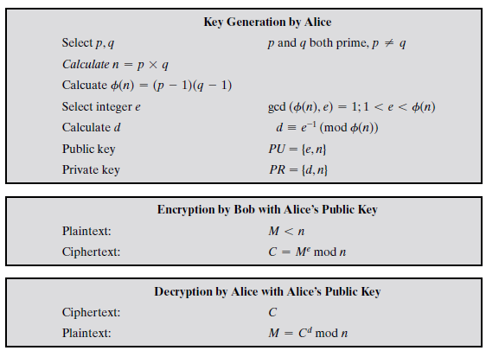
RSA Algorithm

Slide 28
RSA Algorithm
For this example, the keys were generated as follows.
1. Select two prime numbers, p = 17 and q = 11.
2. Calculate n = pq = 17 * 11 = 187.
3. Calculate ɸ(n) = (p - 1)(q - 1) = 16 * 10 = 160.
4. Select e such that e is relatively prime to ɸ(n) = 160 and less than ɸ(n); we choose e = 7.
5. Determine d such that de ≡ 1 (mod 160) and d < 160. The correct value is d = 23, because 23 * 7 = 161 = (1 * 160) + 1; d can be calculated using the extended Euclid’s algorithm.
The resulting public key and private key are:
PU = {7, 187}
PR = {23, 187}.

Slide 29
RSA Algorithm
Perform encryption and decryption on M, M = 88
C = Me mod n
C = 88⁷ mod 187
C = 11
88⁷ mod 187 = [(88⁷ mod 187) * (88² mod 187) * (88¹ mod 187)] mod 187
88¹ mod 187 = 88
88² mod 187 = 7744 mod 187 = 77
88⁴ mod 187 = 59,969,536 mod 187 = 132
88⁷ mod 187 = (88 * 77 * 132) mod 187 = 894,432 mod 187 = 11

Slide 30
RSA Algorithm
For decryption,
M = C^{d} mod n
M = 11²³ mod 187
M = 88
11²³ mod 187 = [(11¹ mod 187) * (11² mod 187) * (11⁴ mod 187) * (11⁸ mod 187) * (11⁸ mod 187)] mod 187
11¹ mod 187 = 11
11² mod 187 = 121
11⁴ mod 187 = 14,641 mod 187 = 55
11⁸ mod 187 = 214,358,881 mod 187 = 33
11²³ mod 187 = (11 * 121 * 55 * 33 * 33) mod 187
= 79,720,245 mod 187 = 88

Slide 31
RSA Algorithm
Example : 2
1. Select two prime numbers, p = 13 and q = 17.
2. Calculate n = pq = 13 * 17 = 221.
3. Calculate ɸ(n) = (p - 1)(q - 1) = 12 * 16 = 192.
4. Select e such that e is relatively prime to ɸ(n) = 192 and less than ɸ(n); we choose e = 35.
5. Determine d such that de ≡ 1 (mod 192) and d < 192. The correct value is d = 11, because 11 * 35 = 385 = (2 * 192) + 1; d can be calculated using the extended Euclid’s algorithm.
The resulting public key and private key are:
PU = {35, 221}
PR = {11, 221}.

Slide 32
RSA Algorithm
Perform encryption and decryption on M, M = 08
C = Me mod n
C = 08³⁵ mod 221
For decryption,
M = C^{d} mod n
M = C¹¹ mod 221

Slide 33
RSA Algorithm
Example 3 :
p =11, q = 29, M = 100
2. Calculate n = pq = 11 * 29 = 319.
3. Calculate ɸ(n) = (p - 1)(q - 1) = 10 * 28 = 280.
4. Select e such that e is relatively prime to ɸ(n) = 280 and less than ɸ(n); we choose e = 3.
5. Determine d such that de ≡ 1 (mod 280) and d < 280. The correct value is d = 11, because 187 * 3 = 561 = (2 * 280) + 1; d can be calculated using the extended Euclid’s algorithm.
The resulting public key and private key are:
PU = {35, 221}
PR = {11, 221}.

Slide 34
RSA Algorithm
Perform encryption M, M = 100
C = Me mod n
C = 100³ mod 319
100³ mod 319 = [(100¹ mod 319) * (100² mod 319))] mod 319
100¹ mod 319 = 100
100² mod 319 = 10000 mod 319 = 111
100³ mod 319 = (100 * 111) mod 319 = 11100 mod 319 = 254

